Slide 1
Unit 4 Chapter 1 Storage and Querying

Slide 2
Syllabus Topics
Storage and Querying:
Storage and File structures
Indexed Files
Single Level and Multi Level Indexes
Query Processing
Query Optimization

Slide 3
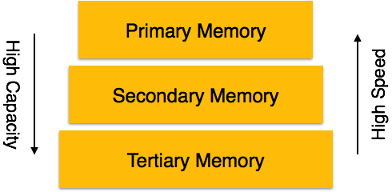
Storage System in DBMS
A database system provides an ultimate view of the stored data.
However, data in the form of bits, bytes get stored in different storage devices.
Types of Data Storage
Primary Storage: The memory storage that is directly accessible to the CPU comes under this category.
CPU's internal memory (registers), fast memory (cache), and main memory (RAM)
Secondary Storage: Secondary storage includes memory devices that are not a part of the CPU chipset or motherboard. Magnetic disks, hard disks, flash drives.
Tertiary Storage: Tertiary storage is used to store huge volumes of data.
Since such storage devices are external to the computer system, they are the slowest in speed. Optical disks (DVD, CD, etc.), magnetic tapes.

Slide 4
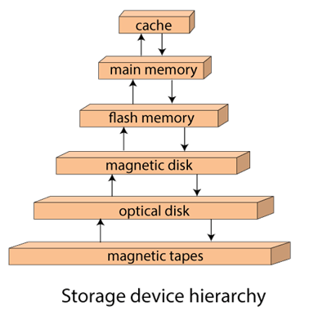
Storage System in DBMS
Redundant Array of Independent Disks
RAID or Redundant Array of Independent Disks, is a technology to connect multiple secondary storage devices and use them as a single storage media.
RAID consists of an array of disks in which multiple disks are connected together to achieve different goals. RAID levels define the use of disk arrays

Slide 5
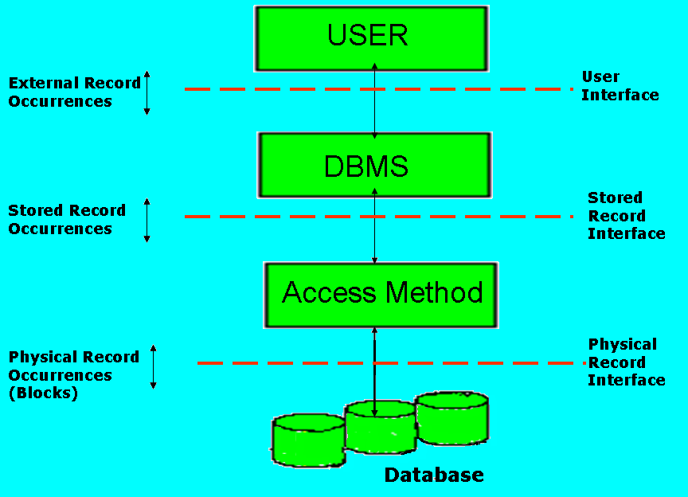
Storage System in DBMS
As we already know that user operations are expressed (via DML) in terms of external records, and must be converted by the DBMS into corresponding operations on Internal or Stored Records.
These latter operations must be converted in turn to operations at the actual hardware level, i.e. to the operations on physical records or blocks.
The component responsible for this internal/ physical conversion is called an Access Method (Fig. 1)
Figure 1

Slide 6
Storage System in DBMS
The Stored Record Interface thus corresponds to the internal level, just as the user interface corresponds to the external level.
The Physical Record Interface corresponds to the actual hardware level.
Thus the stored record interface allows the DBMS to view the storage structure as a collection of stored files, each one consisting of all occurrences of one type of stored record.
Figure 1

Slide 7
Storage System in DBMS
Specifically the DBMS knows the following:
What stored files exist, and, for each one,
The structure of the corresponding stored record.
The stored filed(s), if any, on which it is sequenced.
The DBMS doesn’t know the following:
Anything about Physical Records (Blocks).
How stored fields are associated to form stored records.
Figure 1

Slide 8
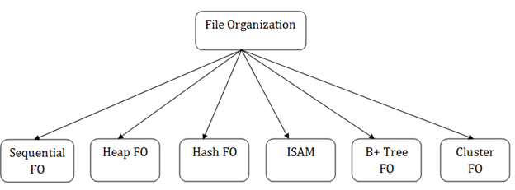
File Structures
The File is a collection of records. Using the primary key, we can access the records. The type and frequency of access can be determined by the type of file organization which was used for a given set of records.
File organization is a logical relationship among various records.
This method defines how file records are mapped onto disk blocks.
File organization is used to describe the way in which the records are stored in terms of blocks, and the blocks are placed on the storage medium.

Slide 9
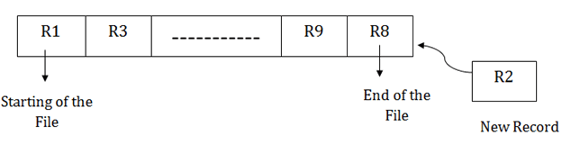
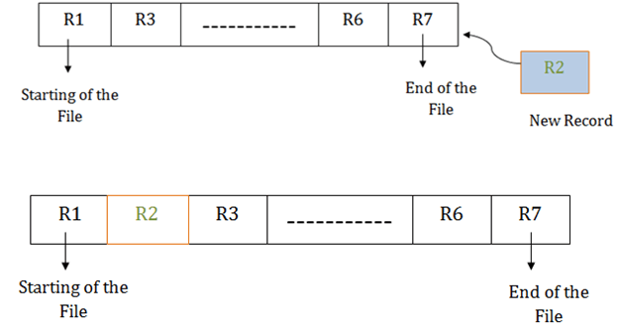
File Structures
Pile File Method:
In this method, we store the record in a sequence, i.e., one after another. Here, the record will be inserted in the order in which they are inserted into tables.
Sorted File Method:
In this method, the new record is always inserted at the file's end, and then it will sort the sequence in ascending or descending order. Sorting of records is based on any primary key or any other key.
In the case of modification of any record, it will update the record and then sort the file, and lastly, the updated record is placed in the right place.

Slide 10
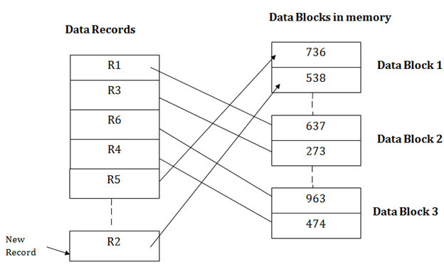
File Structures
Heap file organization
It works with data blocks.
When the records are inserted, it doesn't require the sorting and ordering of records.
When the data block is full, the new record is stored in some other block.
This new data block need not to be the very next data block, but it can select any data block in the memory to store new records.
suppose we want to insert a new record R2 in a heap.
If the data block 3 is full then it will be inserted in any of the database selected by the DBMS, let's say data block 1.

Slide 11
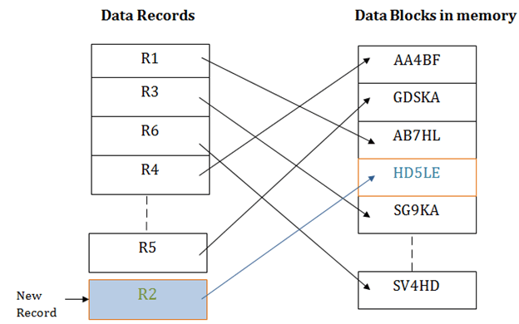
File Structures
Hash File Organization
Hash File Organization uses the computation of hash function on some fields of the records. The hash function's output determines the location of disk block where the records are to be placed.
When a record has to be retrieved using the hash key columns, then the address is generated, and the whole record is retrieved using that address.
In the same way, when a new record has to be inserted, then the address is generated using the hash key and record is directly inserted. The same process is applied in the case of delete and update.

Slide 12
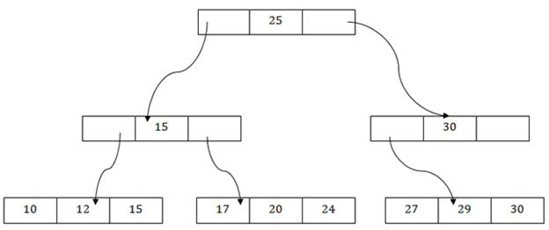
File Structures
B+ File Organization
B+ tree file organization is the advanced method of an indexed sequential access method. It uses a tree-like structure to store records in File.
It uses the same concept of key-index where the primary key is used to sort the records. For each primary key, the value of the index is generated and mapped with the record.
In this method, all the records are stored only at the leaf node. Intermediate nodes act as a pointer to the leaf nodes. They do not contain any records.
There is one root node of the tree, i.e., 25. There is an intermediary layer with nodes. They do not store the actual record. They have only pointers to the leaf node.
The nodes to the left of the root node contain the prior value of the root and nodes to the right contain next value of the root, i.e., 15 and 30 respectively.
There is only one leaf node which has only values, i.e., 10, 12, 17, 20, 24, 27 and 29.

Slide 13
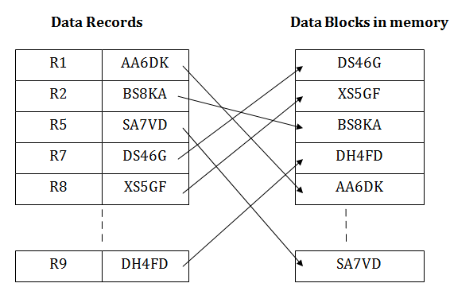
File Structures
Indexed sequential access method (ISAM)
ISAM method is an advanced sequential file organization. In this method, records are stored in the file using the primary key.
An index value is generated for each primary key and mapped with the record. This index contains the address of the record in the file.
If any record has to be retrieved based on its index value, then the address of the data block is fetched and the record is retrieved from the memory.

Slide 14
File Structures
Cluster file organization
When the two or more records are stored in the same file, it is known as clusters.
These files will have two or more tables in the same data block, and key attributes which are used to map these tables together are stored only once.
The cluster file organization is used when there is a frequent need for joining the tables with the same condition.
In this method, we can directly insert, update or delete any record. Data is sorted based on the key with which searching is done. Cluster key is a type of key with which joining of the table is performed.

Slide 15
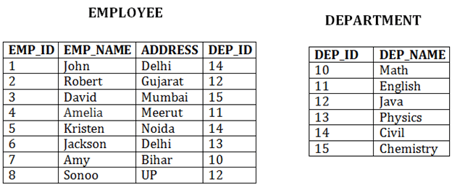
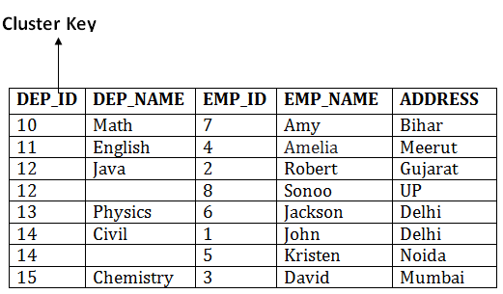
File Structures
In the given example, we are retrieving the record for only particular departments.
Types of Cluster file organization:
1. Indexed Clusters:
In indexed cluster, records are grouped based on the cluster key and stored together. The EMPLOYEE and DEPARTMENT relationship is an example of an indexed cluster. Here, all the records are grouped based on the cluster key- DEP_ID and all the records are grouped.
2. Hash Clusters:
It is similar to the indexed cluster. In hash cluster, instead of storing the records based on the cluster key, it generate the value of the hash key for the cluster key and store the records with the same hash key value.

Slide 16
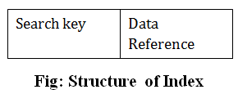
Indexing
Indexing is defined as a data structure technique that allows you to quickly retrieve records from a database file.
Indexing is used to optimize the performance of a database by minimizing the number of disk accesses required when a query is processed.
An Index is a small table having only two columns.
The first column comprises a copy of the primary or candidate key of a table.
Its second column contains a set of pointers for holding the address of the disk block where that specific key value stored.

Slide 17

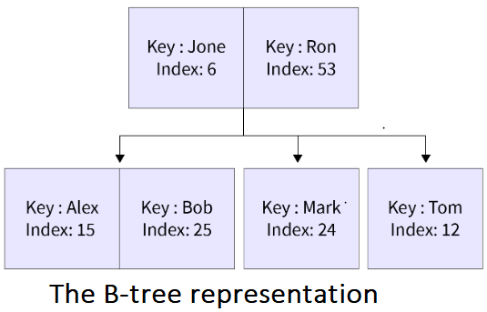
Indexing Attributes
Standard (B-tree) and Bitmap
B-tree is a type of tree data structure that contains 2 things namely: Index Key and its corresponding disk address. Index Key refers to a certain disk address and that disk further contains rows or tuples of data.
Bitmap indexing uses strings to store the address of the tuples or rows. A bitmap is a mapping from one system to the other such as integers to bits.
Note: Oracle Database uses Bitmap and B-trees.

Slide 18
Indexing Attributes
Ascending and Descending
Columns of the index are stored in some sorted manner.
Generally, we store these Search Keys in ascending order. These sorted keys allow us to search data the data fastly. We can change the sort order from ascending to descending .
CREATE INDEX index_name ON table-name (column-name_1, column-name_2 DESC);
By default Sorting Order:
Character Data: Sorted by ASCII values of the characters.
Numeric Data: Smallest to largest numbers.
Date: Earliest date to the latest date.

Slide 19
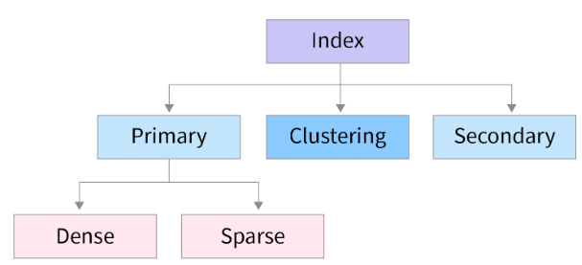
Types of Indexes
Single Level Indexing
It is somewhat like the index (or the table of contents) found in a book.
Index of a book contains topic names along with the page number similarly the index table of the database contains keys and their corresponding block address.
Single Level Indexing is further divided into three categories:
Primary Indexing:
The indexing or the index table created using Primary keys is known as Primary Indexing. It is defined on ordered data.
As the index is comprised of primary keys, they are unique, not null, and possess one to one relationship with the data blocks.

Slide 20
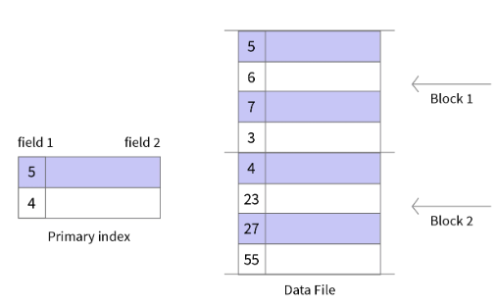
Types of Indexes
Characteristics of Primary Indexing:
Search Keys are unique.
Search Keys are in sorted order.
Search Keys cannot be null as it points to a block of data.
Fast and Efficient Searching.

Slide 21
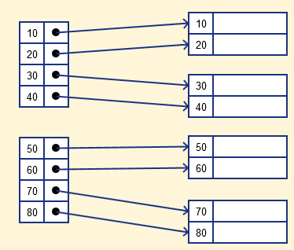
Types of Indexes
The primary Indexing in DBMS is also further divided into two types.
Dense Index
Sparse Index
Dense Index
In a dense index, a record is created for every search key valued in the database.
This helps you to search faster but needs more space to store index records.
In this Indexing, method records contain search key value and points to the real record on the disk.

Slide 22
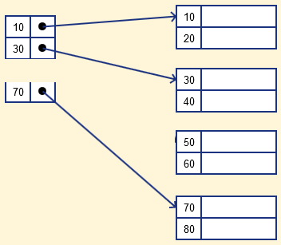
Types of Indexes
Sparse Index
Sparse Index helps you to resolve the issues of dense Indexing in DBMS.
In this method of indexing technique, a range of index columns stores the same data block address, and when data needs to be retrieved, the block address will be fetched.
Sparse Index stores index records for only some search-key values. It needs less space, less maintenance overhead for insertion, and deletions but It is slower compared to the dense Index for locating records.

Slide 23
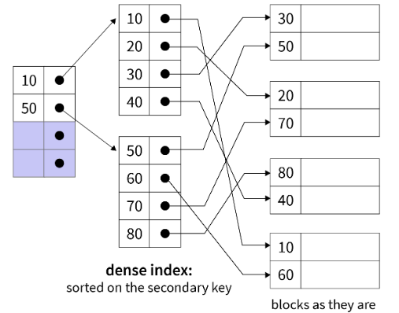
Types of Indexes
Secondary Indexing:
It is a two-level indexing technique used to reduce the mapping size of the primary index.
Secondary Indexing is also known as non-clustered Indexing.
In a bank account database, data is stored sequentially by acc_no; you may want to find all accounts in of a specific branch of ABC bank.
Characteristics of Secondary Indexing:
Search Keys are Candidate Keys.
Search Keys are sorted but actual data may or may not be sorted.
Requires more time than primary indexing.
Faster than clustered indexing but slower than primary indexing.

Slide 24
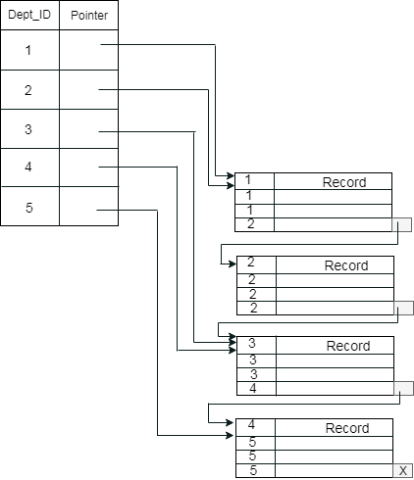
Types of Indexes
Cluster Indexing:
Clustered Indexing is used when there are multiple related records found at one place.
The important thing to note here is that the index table of clustered indexing is created using non-key values which may or may not be unique.
To achieve faster retrieval, we group columns having similar characteristics. The indexes are created using these groups and this process is known as Clustering Index.
Let’s assume that a company recruited many employees in various departments. In this case, clustering indexing in DBMS should be created for all employees who belong to the same dept.
Here, Department _no is a non-unique key.

Slide 25
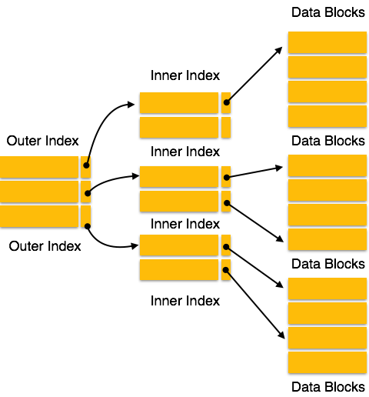
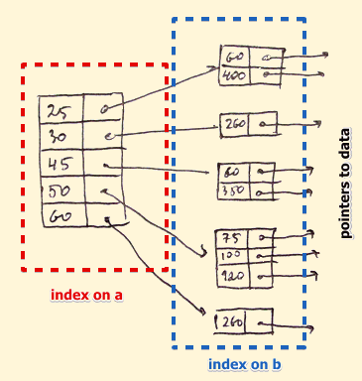
Types of Indexes
Multilevel Indexing:
Since the index table is stored in the main memory, single-level indexing for a huge amount of data requires a lot of memory space.
Hence, multilevel indexing was introduced in which we divide the main data block into smaller blocks.
This makes the outer block of the index table small enough to be stored in the main memory.
B-Tree Index
B-tree index is the widely used data structures for tree based indexing in DBMS.
It is a multilevel format of tree based indexing in DBMS technique which has balanced binary search trees.
All leaf nodes of the B tree signify actual data pointers.

Slide 26
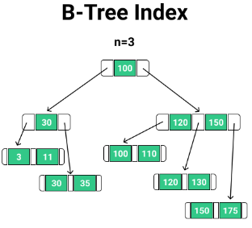
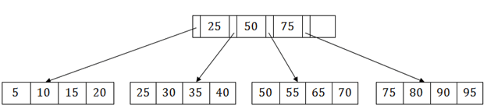
Types of Indexes
B-Tree Index
The leaf nodes are themselves in the form of a linked list. This linked list representation helps in both sequential and random access.
Suppose we have to search 55 in the above B+ tree structure. First, we will fetch for the intermediary node which will direct to the leaf node that can contain a record for 55.
So, in the intermediary node, we will find a branch between 50 and 75 nodes. Then at the end, we will be redirected to the third leaf node. Here DBMS will perform a sequential search to find 55.

Slide 27
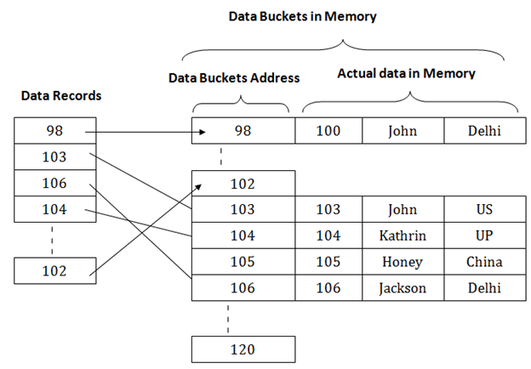
Hashing
Hashing technique is used to calculate the direct location of a data record on the disk without using index structure.
In this technique, data is stored at the data blocks whose address is generated by using the hashing function.
The memory location where these records are stored is known as data bucket or data blocks.
In this, a hash function can choose any of the column value to generate the address. Most of the time, the hash function uses the primary key to generate the address of the data block.
A hash function is a simple mathematical function.
The above diagram shows data block addresses same as primary key value. This hash function can also be a simple mathematical function like exponential, mod, cos, sin, etc.

Slide 28
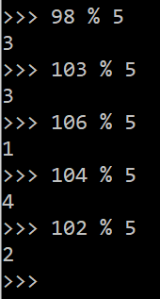
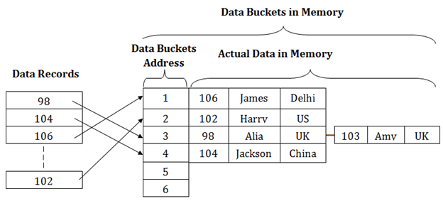
Hashing
Suppose we have mod (5) hash function to determine the address of the data block. In this case, it applies mod (5) hash function on the primary keys and generates 3, 3, 1, 4 and 2 respectively, and records are stored in those data block addresses.

Slide 29
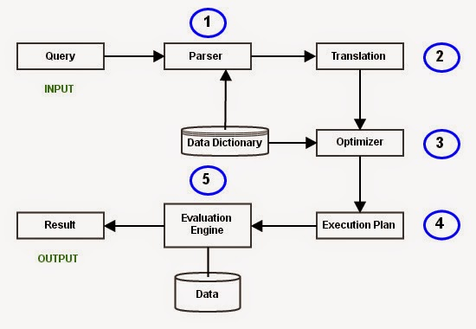
Query Processing and Query Optimization
Query Processing would mean the entire process or activity which involves query translation into low level instructions, query optimization to save resources, cost estimation or evaluation of query, and extraction of data from the database.
Query Processing is a translation of high-level queries into low-level expression.
It requires the basic concepts of relational algebra and file structure.

Slide 30
Query Processing and Query Optimization
Parsing and Translation
The fired queries undergo lexical, syntactic, and semantic analysis.
The query gets broken down into different tokens and white spaces are removed along with the comments (Lexical Analysis).
The query processor first checks the query if the rules of SQL have been correctly followed or not (Syntactic Analysis).
Finally, the query processor checks if the meaning of the query is right or not. Things like if the table(s) mentioned in the query are present in the DB or not? if the column(s) referred from all the table(s) are actually present in them or not? (Semantic Analysis)

Slide 31
Query Processing and Query Optimization
SELECT
emp_name
FROM
employee
WHERE
salary>10000;
Parsing and Translation Example
The above query would be divided into the following tokens:Lexical Analysis)
SELECT, emp_name, FROM, employee, WHERE, salary, >, 10000.
Check for Query syntax: (Syntactic Analysis).
The name of the queried table is looked into the data dictionary table.
The name of the columns mentioned (emp_name and salary) in the tokens are validated for existence.
The type of column(s) being compared have to be of the same type (salary and the value 10000 should have the same data type). (Semantic Analysis)

Slide 32
Query Processing and Query Optimization
SELECT
emp_name
FROM
employee
WHERE
salary>10000;
Parsing and Translation Example
The next step is to translate the generated set of tokens into a relational algebra query. These are easy to handle for the optimizer in further processes.
σ_{salary>10000} (π_{salary} (Employee))
π_{salary} (σ_{salary>10000} (Employee))
After translating the given query, we can execute each relational algebra operation by using different algorithms.
So, in this way, a query processing begins its working.

Slide 33
Query Processing and Query Optimization
Query Optimization
In the next step, DMBS picks up the most efficient evaluation plan based on the cost each plan has.
The aim here is to minimize the query evaluation time. The optimizer also evaluates the usage of index present in the table and the columns being used.
It also finds out the best order of subqueries to be executed so as to ensure only the best of the plans gets executed.
Simply put, for any query, there are multiple evaluation plans to execute it. Choosing the one which costs the least is called Query Optimization.

Slide 34
Query Processing and Query Optimization
Query Optimization
Some of the factors weighed in by the optimizer to calculate the cost of a query evaluation plan is:
CPU time
Number of tuples to be scanned
Disk access time
number of operations

Slide 35
Query Processing and Query Optimization
Execution Plan
A query can be expressed in many ways.
The query processor module, at this stage, using the information collected in Optimization step to find different relational algebra expressions that are equivalent and return the result of the one which we have written already.
So far, we have got two execution plans. Only condition is that both plans should give the same result.

Slide 36
Query Processing and Query Optimization
Query execution engine
A query execution engine is responsible for generating the output of the given query.
At this stage, we choose one execution plan of the several we have developed.
This Execution plan accesses data from the database to give the final result.

Slide 37
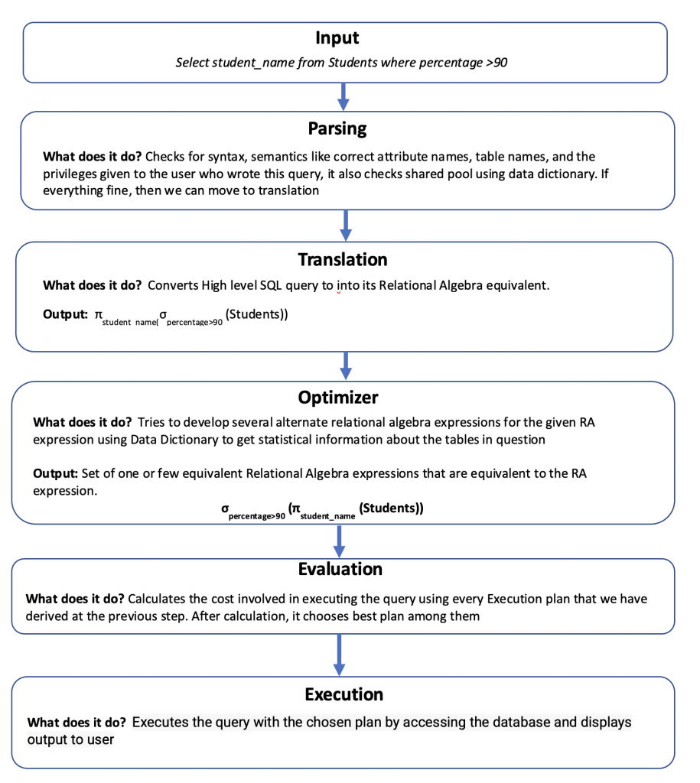
Query Processing and Query Optimization
Summary

